Slide 1
Natural Language Processing Workshop
Session 1

Slide 2
Content
Exercise: Build your first bot
What is chatbot & Type of Chatbots
What is Rasa?
Review chatbot architecture

Slide 3
Exercise: 1
Build your first chatbot

Slide 4
Exercise: Chatbot to cheer you up
Open folder exercise-1
Follow the instructions

Slide 5
Chatbot & Type
What is chatbot & type of chatbot

Slide 6
Chatbot
Conversational assistant
Suit your needs
Save your time

Slide 7
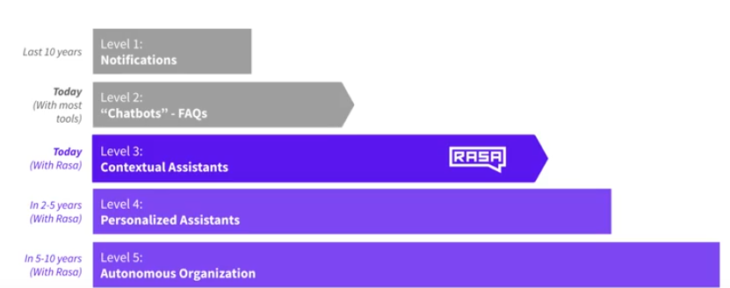
Types of Chatbots

Slide 8
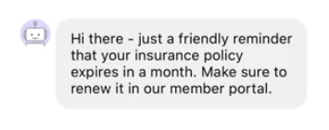
Types of Chatbots: Notification
SMS/Email assistants: Notifies you of order status.

Slide 9
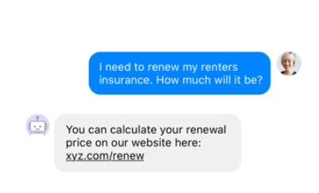
Types of Chatbots: FAQs assistants
Simple preconfigured – Differs from notification by follow up questions.
State machine – set of rules
State machines – Complex over time

Slide 10
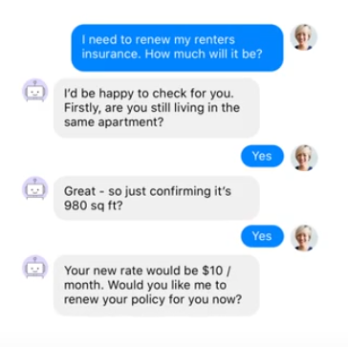
Types of Chatbots: Contextual assistants
Natural language understanding.
Understanding context
Context of conversation – recommend me a book → Harry potter → Is that fiction or non-fiction?
Handle unexpected conversation and chit chat

Slide 11
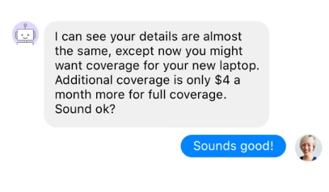
Types of Chatbots: Personalized assistants
Reviews your email/credit cards.
Remember your preferences.
Advice on insurance/investment portfolios

Slide 12
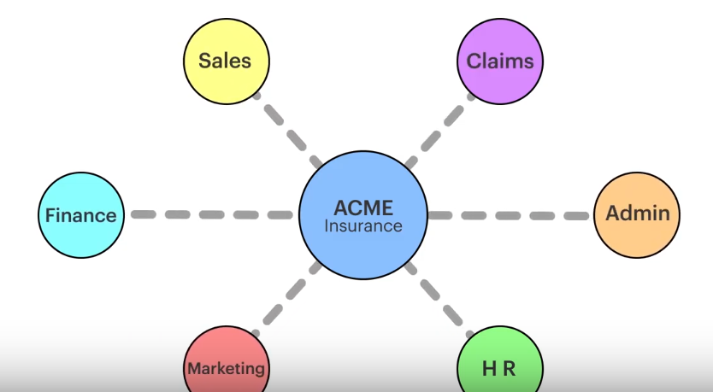
Types of Chatbots: Autonomous organization
Take over a wide portfolio.
Advice over wide variety of aspects.
Real life conversations

Slide 13
RASA
What is RASA & What can you do with it?

Slide 14
RASA
Rasa is a set of open source machine learning tools for developers for conversational AI.
TWO PARTS:
NLU: a natural language processing tool for intent classification and entity extraction.
Core: framework for machine learning based contextual decision making.

Slide 15
RASA: Architecture
Entities & Intents

Slide 16
RASA NLU: Intents and Entities
RASA NLU
Hello. My name is Dinesh.
Entity: Dinesh(Name)
Intent: Greeting

Slide 17
RASA CORE: Dialogue management & Decision making
Hi.
Next best action:
utter_ask_name: 89%
utter_greet_user: 11%
Hi, My name is Sara the chatbot. What is your name?

Slide 18
RASA: Architecture
Exercise: Review & set up health care chatbot

Slide 19
Review:
What would be building? - Covid 19: Start the development of health care bot.
Learn the fundamental of conversation design
Generate the training data for NLU

Slide 20
Review: Chatbot use case
Hi. I am looking for hospital
USE CASE:
Customer wants to find out a nearby hospital or nursing home, dentist etc.
The bot asks for his/her location, calls. After customer provides the location, the bot will look up nearest hospital but calling a service or looking up a database.
The bot responds with the closest hospital.
Sure! Can you please provide me your city name or zip code?
Charlotte
1322 North medial plaza Charlotte NC

Slide 21
Exercise: 2
Open the nlu.md file under data folder
Review the intents
Open the stories.md files under data folder
Review the stories

Slide 22
Exercise: Design process
Who will be my users?
What are their needs?
Why will they use assistant? Ex – Transfer account, confirm one time pin (Wrong use case)
Most difficult question that they will ask the bot?

Slide 23
Exercise: Identify
Who will be my users?
What are their needs?
Why will they use assistant? Ex – Transfer account, confirm one time pin (Wrong use case)
Most difficult question that they will ask the bot?

Slide 24
Exercise: Data needs
Domain experts
Most common search queries on the web
Chat history or recorded call logs.
Wizard of all technique – 1:1 conversation

Slide 25
Exercise: Chatbot data needs
Who will be my users? – Patients, Users new to area & Family of patients
What are their needs? – Nursing home, hospital, dentist, specilaists
Why will they use assistant?- Self, For family member, medical emergency, On the road accident etc.
Most difficult question that they will ask the bot?- Hospitals with cancer specialty or special child unit, ICU etc.
Find me a hospital in 28027 zipcode.

Slide 26
Exercise: Chatbot design flow
Cust: Hi
Bot: Hi! How can I help you?
Cust: Find me a hospital in Charlotte?
Bot: Sure. Looking
Bot: The closes hospital is at 1322 Medical Plaza drive
Cust: Thank you!
Bot: You are welcome
Cust: Hi
Bot: Hi! How can I help you?
Cust: Find me a hospital?
Bot: Sure. What is your city or zip code?
Cust: Charlotte NC
Bot: Got it. Give me a sec …
Bot: The closes hospital is at 1322 Medical Plaza drive
Cust Thank you!
Bot: You are welcome

Slide 27
Exercise: Add the questions to your chatbot
Follow steps in exercise 2 - NLU

Slide 28
Break: 5 minutes to wrap up and try
Play with more data and add more data if you like

Slide 29
Exercise: Sentence structure & entities
Exercise: Help the bot identify sentence structure and identify entities

Slide 30
Entities: Entity extraction
Why do we need it?
Fancy word for old children game – NPAT
How to tell bot to identify entites

Slide 31
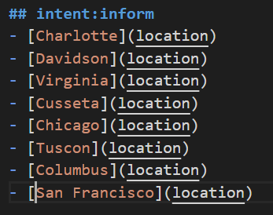
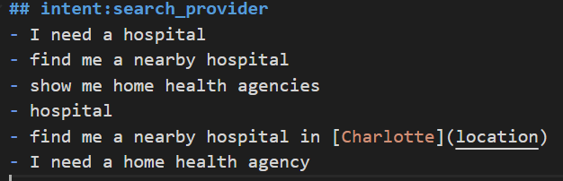
Entities: Entity extraction
[Charlotte](location)
Entity
Label: What type? location

Slide 32
Exercise: Add the entities to your bot
Follow steps in exercise 3 - NLU

Slide 33
Break: 5 minutes to wrap up and try
Play with more data and add more data if you like.
Try adding a zipcode as new enity and label it
See if you can see zipcode as identified entity in the response.

Slide 34
FAQs: How much data do I need
Start with 10-15 examples per intent.
No need to define all data for that intent. Leave some work for backend API ☺ (To be discussed in Session 2 of this meetup)
Use high quality examples only and ensure that they map to actual intent. (How’s the weather near hospital? -- XX)
High quality vocabulary (Prep bot for SATs)

